Slide 1
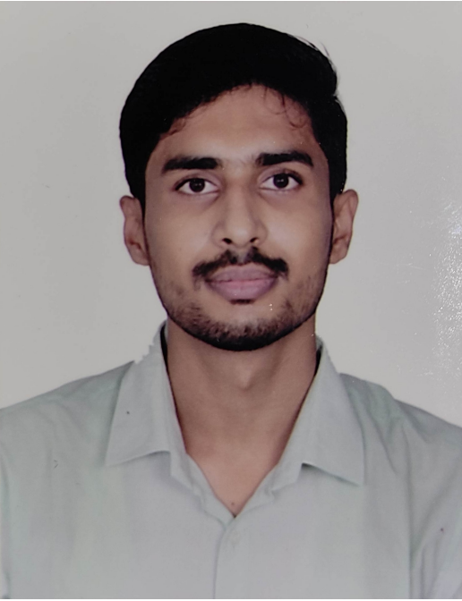





EXPERIENCE
Analyst/Software Engineer
(Apr 2022 - Present)
CAPGEMINI - Bangalore
EDUCATION
B.Tech.
(2017-2021)
RAJIV GANDHI PROUDYOGIKI VISHWAVIDYALAYA, BHOPAL
Specialization- Computer Science and Engineering
Nishant Pratap
Analyst/Software Engineer
LIBRARY MANAGEMENT SYSTEM
(MAJOR PROJECT)
(Feb 2021 – Apr 2021)
TECHNOCRATS INSTITUTE OF TECHNOLOGY (EXCELLENCE) – Bhopal, Madhya Pradesh
A library management system is software that is designed to manage all the functions of a library. It helps librarian to maintain the database of new books.
Technology & Tools :- Java, Ms. Access 2007 , Net Beans , Java Server Page
SUMMARY
INTERMEDIATE
(2015-2017)
PARWATI SCIENCE COLLEGE, MADHEPURA (BIHAR)
Specialization- SCIENCE (PCM)
I am well-versed in Technology and writing code to create systems that are reliable and user-friendly. I can contribute towards the organizational goals through my analytical skills and knowledge acquired by pursuing a degree in Software Engineering. Aiming to leverage proven creative thinking, multitasking, and problem-solving skills. Confident communicator and innovative creator to develop software that is customized to meet a company’s organizational needs.
ONLINE MOBILE STORE
(MINOR PROJECT-II)
(Aug 2020 – Oct 2020)
TECHNOCRATS INSTITUTE OF TECHNOLOGY (EXCELLENCE) – Bhopal, Madhya Pradesh
The project “ONLINE MOBILE PHONE SHOP” is to develop an Internet based sale and purchase system for mobile.
Technology & Tools :- Java, MYSQL, JDBC, Java Server Page
CERTIFICATIONS
Web Development offered by IIT KHARAGPUR
Computer Networks online course offered by NPTEL
Database Design online course offered by NPTEL
Agile Software Development online course offered by COURSERA
Channel Management and Retailing online course offered by IE Reinventing Higher Education
KEY SKILLS
FOOD BILLING SYSTEM
(MINOR PROJECT-I)
(Feb 2020 – Mar 2020)
TECHNOCRATS INSTITUTE OF TECHNOLOGY (EXCELLENCE) – Bhopal, Madhya Pradesh
The main objective of this project is to develop a client/server model, which deals with “FOOD BILLING SYSTEM”.
Java
.NET (Desktop Application and Web-MVC)
Data Structure and Algorithms
C
Agile Software Development
9340680426
Nishant.pratap@capgemini.com

